Slide 1
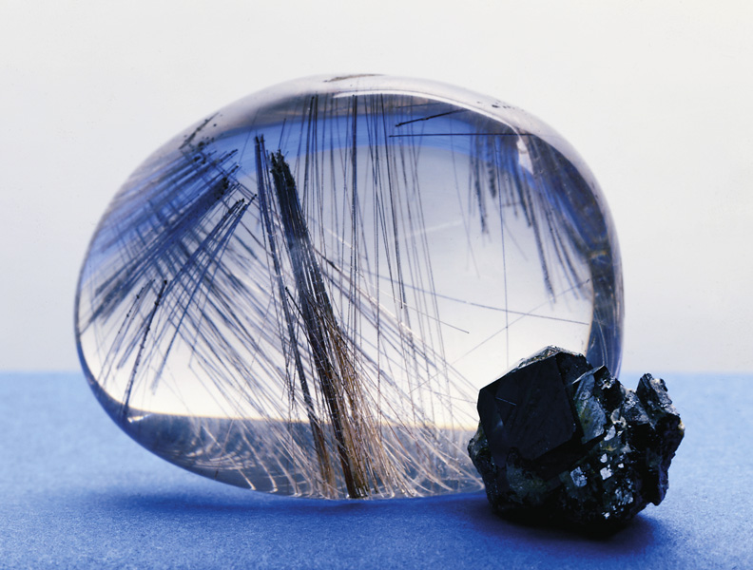
Chapter 24: The Transition Metals
General Chemistry
Principles and Modern Applications
Petrucci • Harwood • Herring
8th Edition
Philip Dutton
University of Windsor, Canada
N9B 3P4
Prentice-Hall © 2002

Slide 2
Contents
24-1 General Properties
24-2 Principles of Extractive Metallurgy
24-3 First-Row Transition Elements: Scandium to Manganese.
24-4 The Iron Triad: Iron, Cobalt and Nickel
24-5 Group 11: Copper, Silver and Gold
24-6 Group 12: Zinc, Cadmium and Mercury
Focus On High Temperature Superconductors

Slide 3
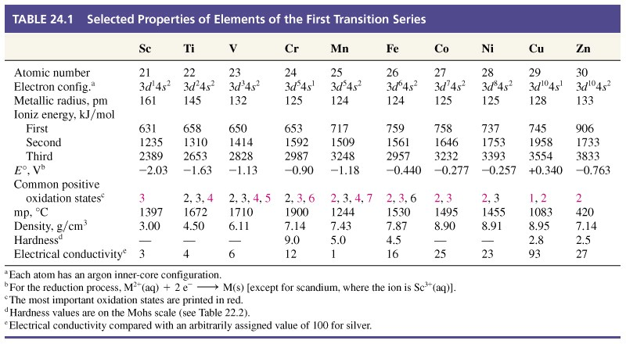
24-1 General Properties

Slide 4
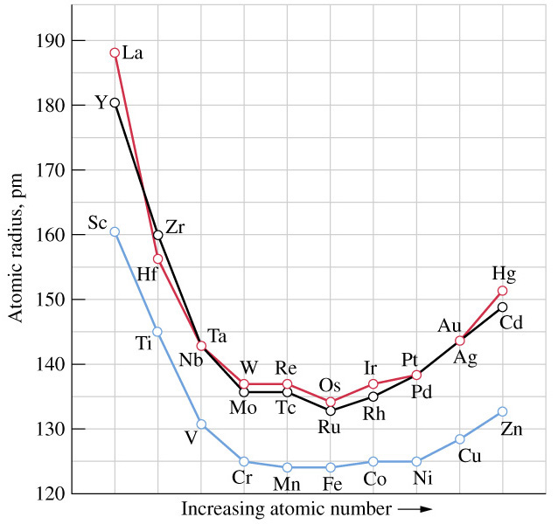
Atomic Radii

Slide 5
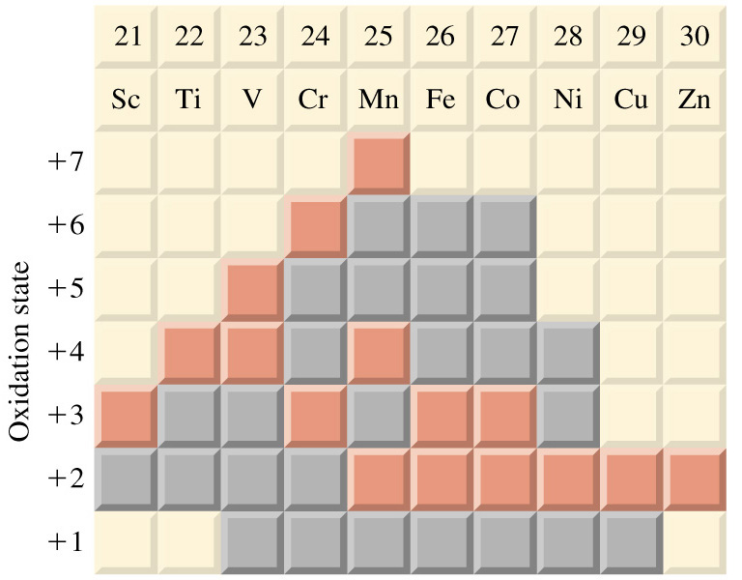
Oxidation States

Slide 6
Compounds
Transition metal compounds display both ionic and covalent character.
  MnO mp 1785 C.
  Mn₂O₇ boils at r.t. and is highly explosive.
Often occur as polyatomic cations or anions.
  VO₂⁺, MnO₄⁻,and Cr₂O₇²⁻ for example..

Slide 7
Catalysis
Catalysis plays an essential aspect in about 90% of all chemical manufacturing.
Ni and Pt are very heterogeneous catalysts.
Pt, Rh, and Pd are used in catalytic converters.
V₂O₅ is used in conversion of SO₂ to SO₃.
Polyethylene is formed catalytically.

Slide 8

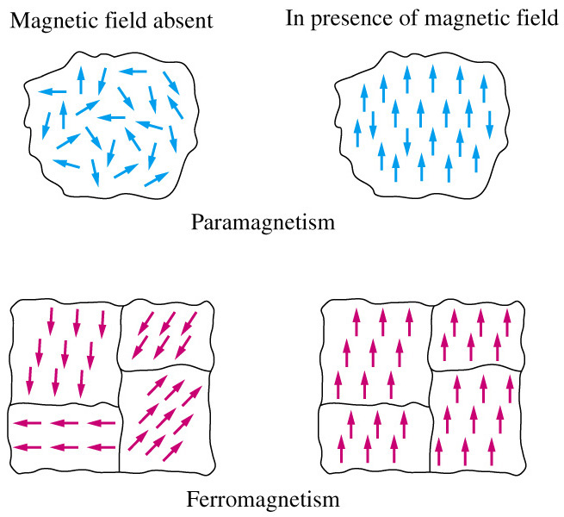
Color and Magnetism

Slide 9
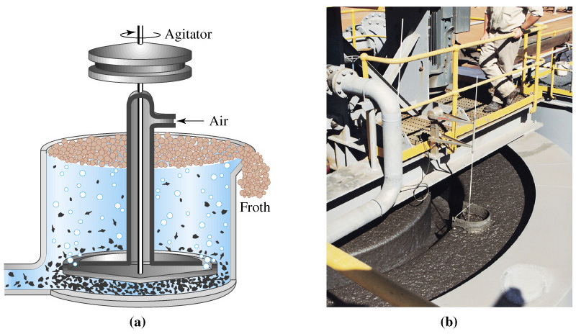
24-2 Principles of Extractive Metallurgy

Slide 10
Metallurgy
Concentration.
  Separate ore from waste rock.
Roasting.
  Heat to a high temperature to form the oxide.
Reduction.
  Commonly use carbon as coke or powdered coal.
Refining.
  Metals must be purified.

Slide 11
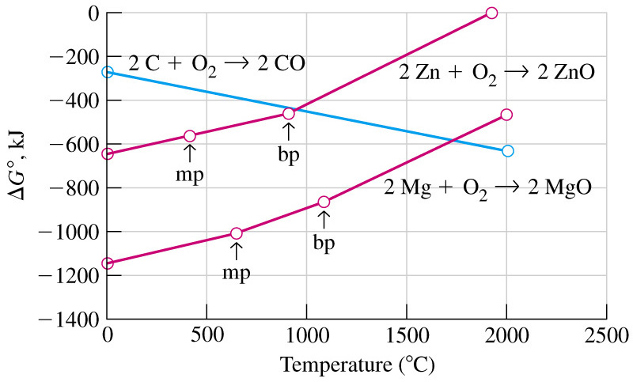
Free Energy of the Reduction Step

Slide 12
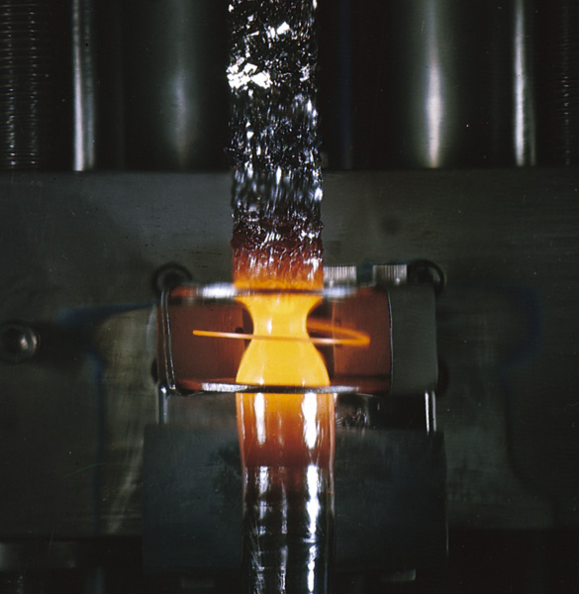
Zone Refining

Slide 13
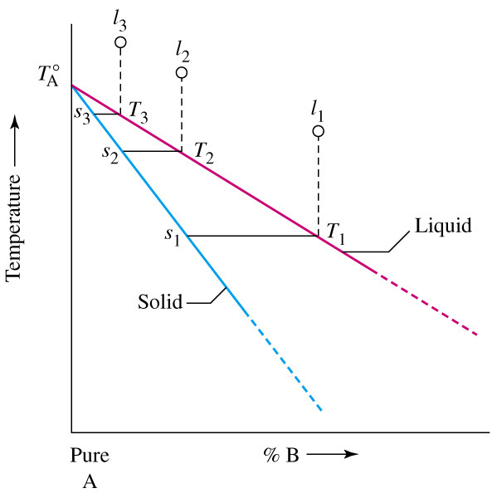
Principles of Zone Refining

Slide 14
Alternative Methods
Many ores contain several metals and it is not always necessary to separate them.
  Fe(CrO₂)₂ can be reduced to ferrochrome and can be added directly to iron to produce steel.
  V₂O₅ and MnO₂ are also added to iron to produce other types of steel.
Titanium cannot be produced by reduction with C.
  In the Kroll process Mg is used.

Slide 15
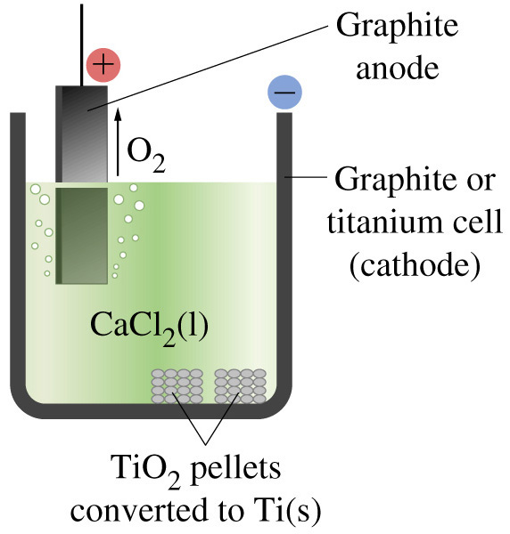
Electrolytic Production of Ti

Slide 16
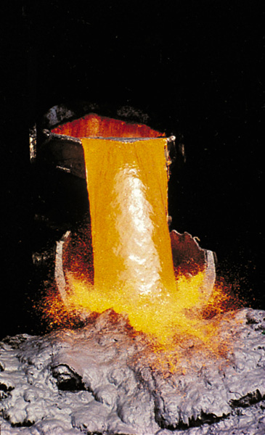
Metallurgy of Copper
Concentration of sulfide ore is done by floatation.
Smelting at 800C converts CuS to CuO.
Copper matte contains CuO/FeS
Slag (Fe, Ca, Al and Si).
  FeO(s) + SiO₂(s) → FeSiO₃(l) for example
Conversion (blow air through molten matte) and form iron slag.
Blister copper contains SO₂ bubbles and can be used where high purity is not essential (or purify electrochemically).

Slide 17
Pyrometallurgical Processes
The roasting – reduction process is known as pyrometallurgy.
Large quantities of waste material is produced in concentrating low grade ore.
High energy consumption.
Gaseous emission must be controlled.

Slide 18
Hydrometallurgical Processes
Leaching: Metal ions are extracted from the ore by a liquid.
  Acids, bases and salts may be used.
  Oxidation and reduction may also be involved.
Purification and concentration.
  Adsorption of impurities on activated charcoal or by ion exchange.
Precipitation.
  Desired ions are precipitated or reduced to the free metal.
  Electroanalytical methods are often used.

Slide 19
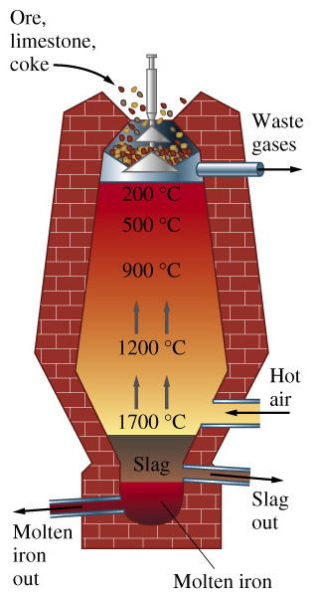
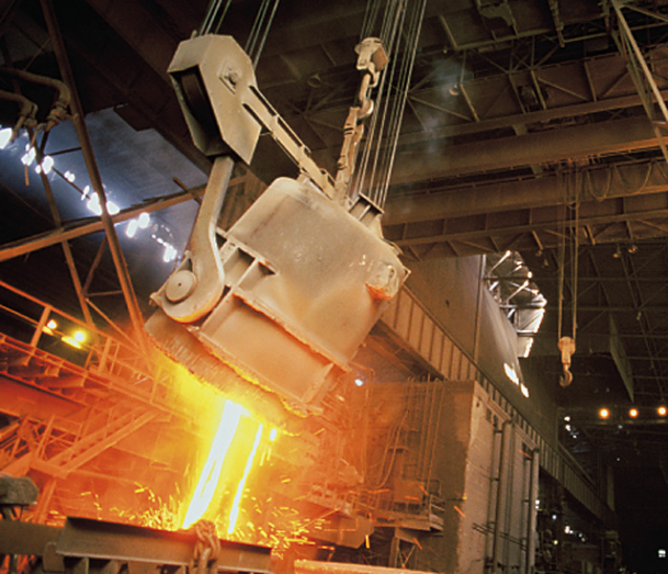
24-3 Metallurgy of Iron and Steel.
Fe₂O₃(s) + 3 CO(g) → 2 Fe(l) + 3 CO₂(g)

Slide 20
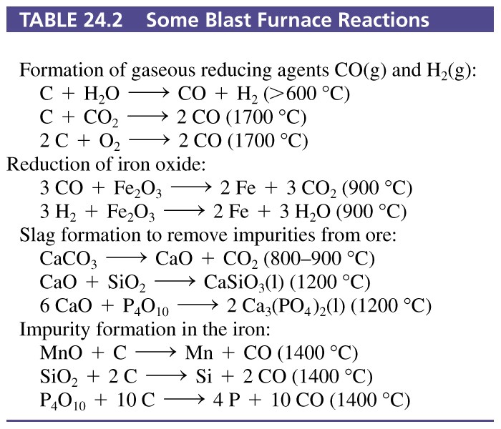
Table 24-2 Some Blast Furnace Reactions

Slide 21
Steel
Three fundamental changes from pig iron.
  Reduction of the C content.
    3-4% in pig iron
    0-1.5% in steel.
  Removal, through slag formation, of:
    Si, Mn, P (about 1% in pig iron)
    Other minor impurities.
  Addition of alloying elements.
    Cr, Ni, Mn, V, Mo, and W.
      Give the steel its desired properties.

Slide 22
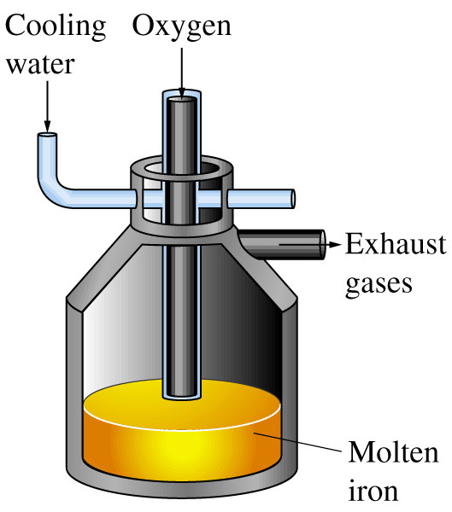
Basic Oxygen Process
Notes:
Oxygen at 10 atm delivered by the lance to just above the molten iron. Reactions on next slide. 20 minute reaction time.

Slide 23
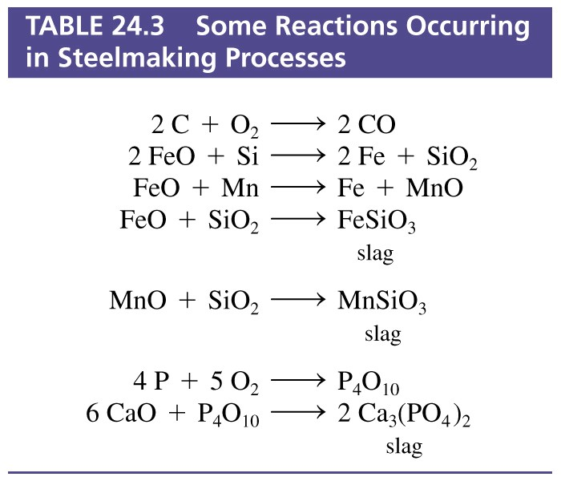
Table 24-3 Some Reactions Occurring in Steelmaking Processes

Slide 24
24-4 First-Row Transition Elements: Scandium to Manganese
Scandium.
  Obscure metal, 0.0025% of earths crust.
  More abundant than many better known metals.
  Limited commercial use.
  Produced in kg quantities not tons.
  Sc³⁺ most closely resembles Al³⁺.
    Amphoteric gelatinous hydroxide Sc(OH)₃.

Slide 25
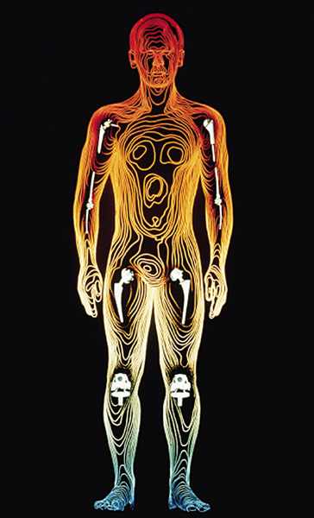
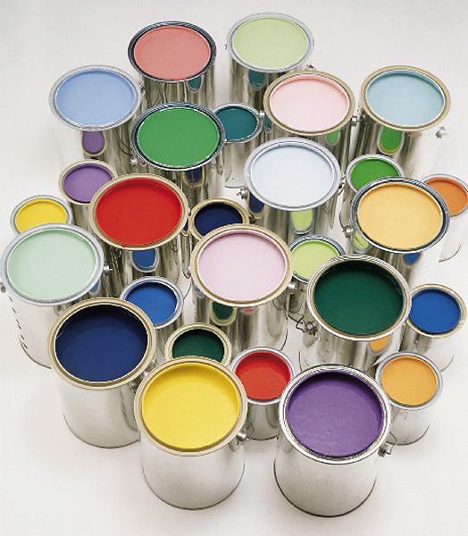
Titanium

Slide 26
Titanium
Several compounds are of particular commercial importance:
  TiCl₄ is the starting material for other titanium compounds.
  Used to formulate catalysts for plastics.
    TiCl₄(l) + H₂O(l) → TiO₂ + 4 HCl
  TiO₂ opaque, inert and non-toxic.
  Paint pigment, paper whitener, additive in glass, ceramics and cosmetics.

Slide 27
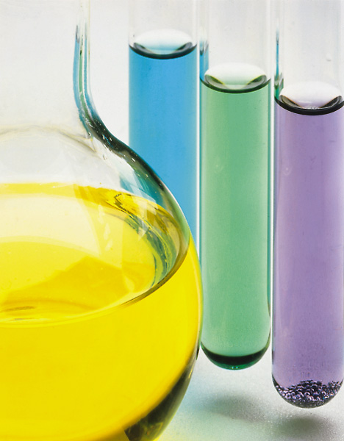
Vanadium
Fairly abundant (0.02%)
Vanadite 3Pb₃(VO₄)₂·PbCl₂
Ferrovanadium 35-95% V in Fe
  Steels are used in applications requiring strength and toughness.
Vandium pentoxide.
  Catalyst.
  Reversible loss of O from 700-1000 C.
Wide variety of oxidation states.
+5 +4 +3 +2

Slide 28
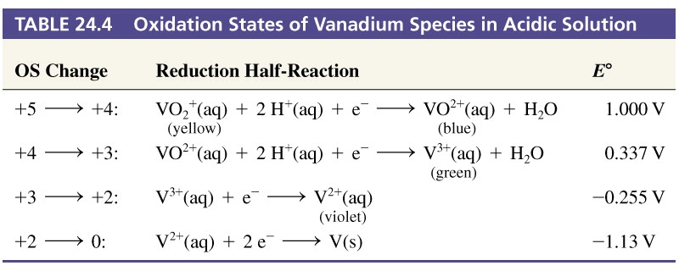
Table 24.4 Oxidation States of Vanadium Species in Acidic Solution

Slide 29
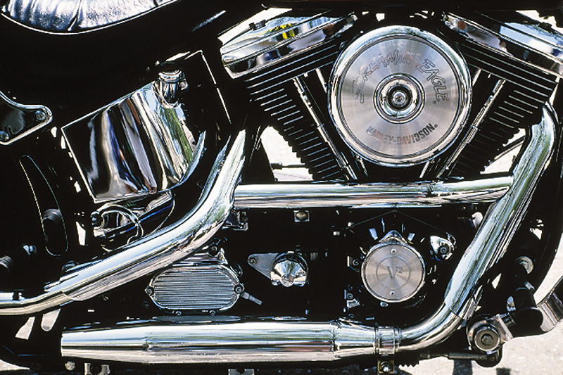
Chromium
Important industrial metal present in earths crust at 0.0122%.
Chromite Fe(CrO₂)₂
Hard, maintains a bright surface, corrosion resistant.
Notes:
Thin and porous layer of Cr is plated over Ni or Cu which provides the real protective layer.

Slide 30
Chromium
2+
Cr(H₂O)₆²⁺, blue
3+
3+
(acidic) Cr(H₂O)₆³⁺, blue
(basic) Cr(OH)₄⁻, green
6+
(acidic) Cr₂O₇²⁻, orange
(basic) Cr₂O₄²⁻, yellow
CrO Cr₂O₃ CrO₃
acidic amphoteric basic

Slide 31
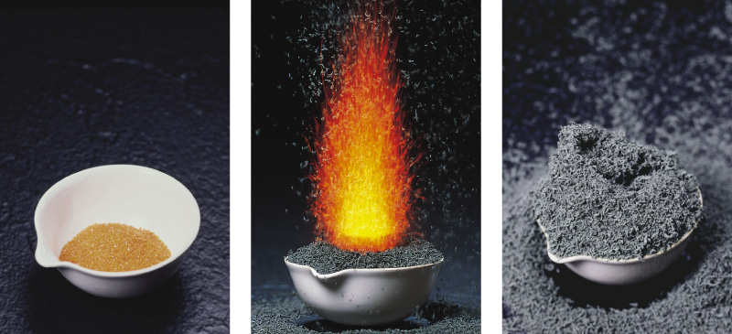
Chromium

Slide 32
Manganese
Fairly abundant, about 1% of earths crust.
Pyrolusite MnO₂.
  Important in steel production.
  MnO₂ + Fe₂O₃ + 5 C → Mn + 2 Fe + 5 CO
Mn reacts with O and S which can then be removed through slag formation.
Oxidation states range from +2 to +7
ferromanganese

Slide 33
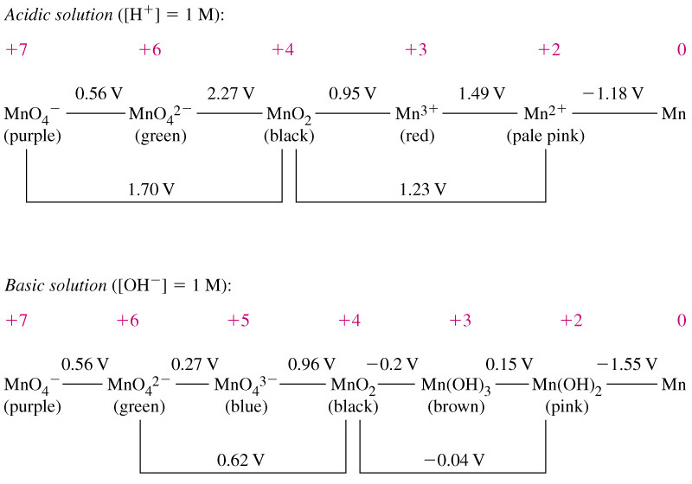
Manganese Oxidation States

Slide 34
24-5 The Iron Triad: Iron, Cobalt and Nickel
Iron
  annual worldwide production over 500 million tons.
  Most important metal in modern civilization.
  4.7% natural abundance.
Cobalt
  0.0020% natural abundance.
  Deposits are reasonably concentrated.
  Primarily used in alloys, Co₅Sm makes a good magnet.
Nickel
  24th most abundant element.
  Primarily used in alloys, but also for electroplating.

Slide 35
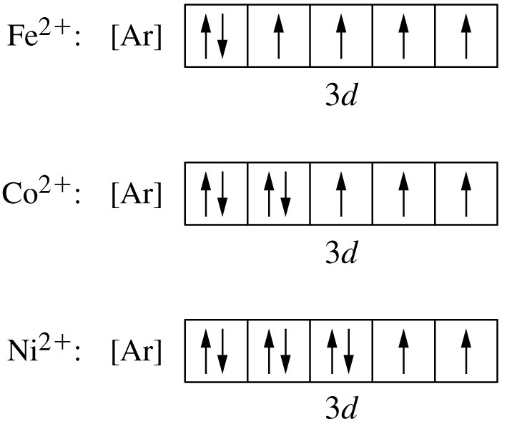
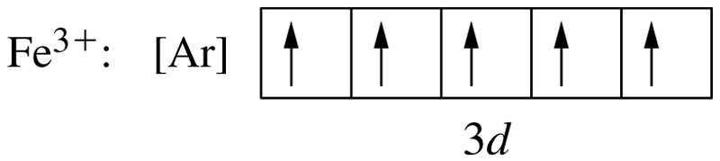
Oxidation States

Slide 36
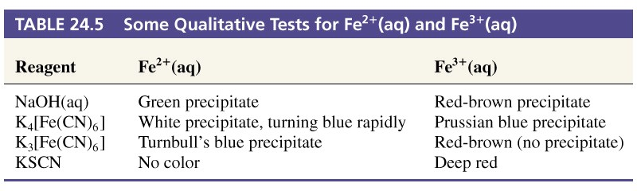
Some Reactions of the Iron Triad

Slide 37
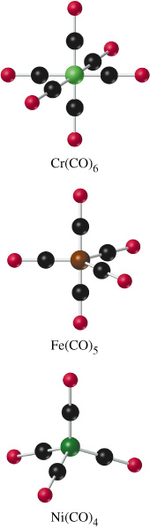
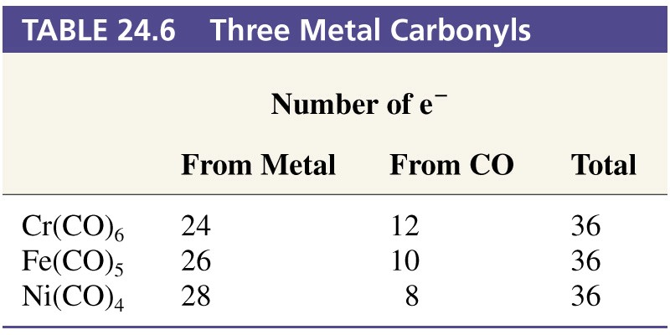
Metal Carbonyls

Slide 38
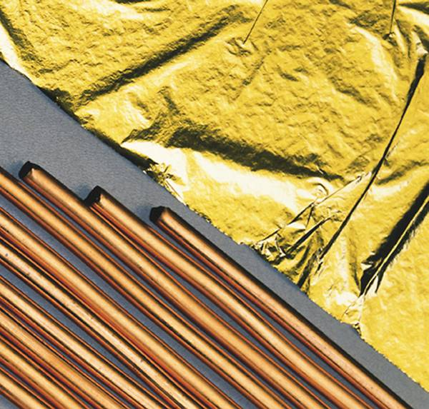
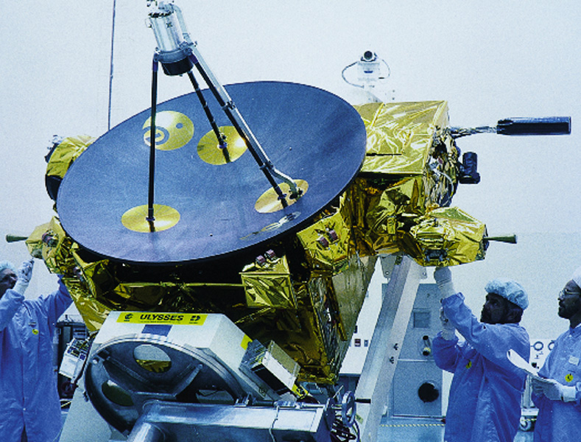
24-6 Group 11: Copper, Silver and Gold
Coinage metals.
Easy to reduce to free metals.
In Mendeleev’s table they were grouped with the alkali metals (single s electron).
Use d electrons in chemical bonding.
Notes:
Ionization energies are vastly different from group 1.
E° are positive for group 11 and negative for group 1.
Exhibit paramagnetism and color in complex compounds.
Excellent physical properties, malleability, ductility.
Excellent electrical and thermal conductivity.

Slide 39
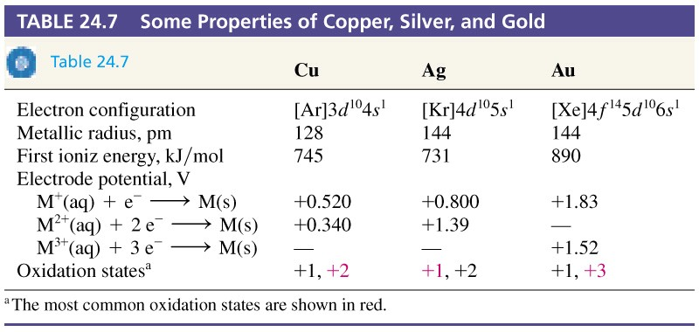
Table 24.7 Some Properties of Copper, Silver, and Gold

Slide 40
24-7 Group 12: Zinc, Cadmium and Mercury
Properties consistent with elements having a full subshell, (n-1)d¹⁰ns².
Mercury is the only room temperature liquid metal.
  Relativistic effect
    6s electrons reach a significant fraction of the speed of light.
    Mass of electron increases.
    Size of 6s orbital decreases.

Slide 41
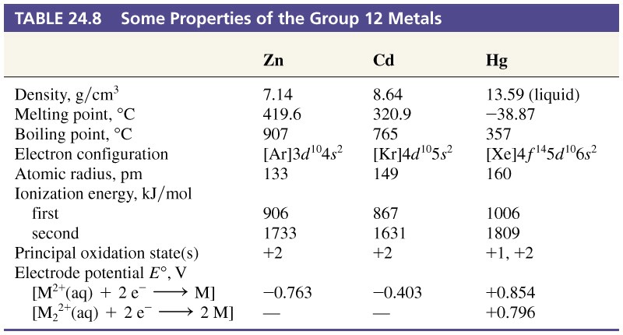
Table 24.8 Some Properties of the
Group 12 Metals.

Slide 42
Uses of Group 12 Metals
Zinc
  About 30% of production goes to plating on Fe.
    Galvanized iron.
  About 20% of production goes to alloys.
    Brass is a Cu alloy with 20-45% Zn and small quantities of Sn, Pb and Fe.
Cadmium
  Bearing alloys.
  Low melting solders.

Slide 43
Uses of Group 12 Metals
Mercury
  Thermometers, barometers, gas-pressure regulators, electrical relays and switches.
  Electrode in the chlor-alkali process.
  Vapor in fluorescent tubes and street lamps.
  Amalgams formed with most metals.

Slide 44
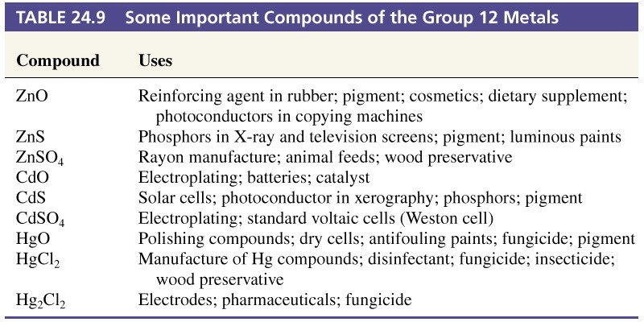
Table 24.9 Some Important Compounds of the Group 12 Metals.

Slide 45
Mercury and Cadmium Poisoning
Hg may interfere with the function of sulfur containing enzymes.
Organomercurials are much more dangerous than elemental mercury.
  Some organisms convert Hg²⁺ compounds to CH₃Hg⁺.
  Bioaccumulation and concentration in the food chain.
Cd closely resembles Zn.
  Itay-itay kyo or ouch-ouch disease.
  Can also cause liver damage, kidney failure and pulmonary disease.

Slide 46
24-8 Lanthanides
Z 58 to 71 are inner transition elements known as rare earth elements, or lanthanides or lanthanoids.
Closely resemble La (Z = 57).
Not particularly rare.
4f orbitals play a minor role in bonding.
Ln³⁺ is the most common oxidation state.

Slide 47
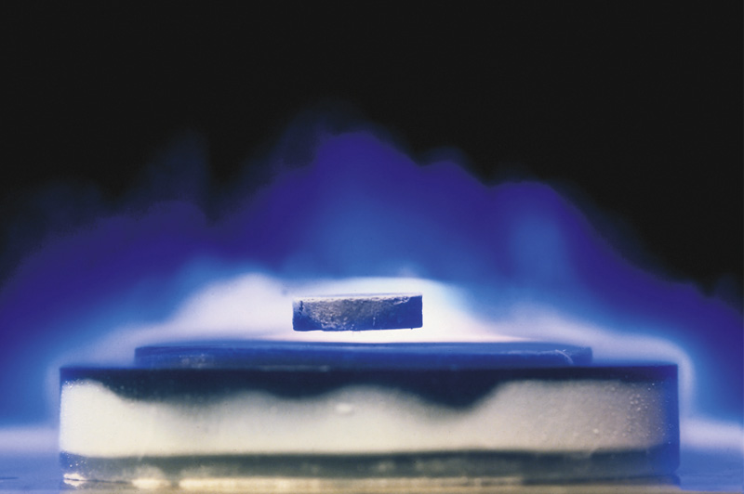
Focus On High-Temperature Superconductors

Slide 48
Chapter 24 Questions
Develop problem solving skills and base your strategy not on solutions to specific problems but on understanding.
Choose a variety of problems from the text as examples.
Practice good techniques and get coaching from people who have been here before.

